Slide 1
Insurance Dispute Resolution in Thailand
Aaron Le Marquer
Partner
Dispute Resolution Department
Tilleke & Gibbins International Ltd.

Slide 2
Typical Disputes
Mainly coverage/quantum disputes in first party Property Damage and Business Interruption claims.
2010 Civil Unrest led to long-running court litigation over whether losses covered under All Risks or Political Violence/Terrorism covers – conflicting judgments rendered. Significant claims $100-150 million.
2011 Floods: most severe flooding catastrophe on record. Economic losses estimated at $45 billion.Many disputes over coverage and reinsurance.

Slide 3
Developing areas
Financial lines: D&O, FIPI
Trade Credit
Environmental Liability
Fertile conditions for cyber claims

Slide 4
Court Procedure
Civil Code jurisdiction
Litigation is primarily adversarial but court has some inquisitorial powers e.g. re appointing experts and ordering submission of evidence.
Trial by professional judges - no juries.
No discovery/disclosure
Cost shifting awards are nominal

Slide 5
3-tier court system
Supreme Court
Court of Appeal
Civil Court
  Permission now needed to appeal to Supreme Court
  No formal system of binding precedent, but Supreme Court judgments generally followed and therefore viewed as authoritative.
  Technical and commercial disputes litigated in IP&IT Court or South Bangkok Civil Court

Slide 6
Arbitration
2002 Arbitration Act – Follows UNCITRAL Model Law
Thai Arbitration Institute (TAI)
Principal institution, under Office of the Judiciary
New Rules in 2017
THAC
Alternative Centre set up with mission to supply arbitration services to international standards

Slide 7
Arbitration (2) - OIC
Mandatory arbitration clause in all policy wordings
Implied where not included
Insured has right to refer dispute to OIC arbitration
Rarely followed in complex commercial disputes

Slide 8
Arbitration (3)
Advantages
  Awards enforceable in foreign jurisdictions
  Proceedings can be conducted in English
  Limited grounds of appeal - finality
Limitations
  Lack of experienced local arbitrators
  Limited grounds of appeal - risk

Slide 9
Mediation
Formal third party mediation services undeveloped in Thailand
THAC mediation centre
Court-supervised mediation process:
  Encourages parties to explore settlement before proceeding with trial
  No engagement with substantive issues
  Concerns over confidentiality and impact on court proceedings

Slide 10
Cross Border Reinsurance Considerations
Thai risks heavily reinsured, leading to participation of international reinsurance markets in most significant cases.
Claims control clauses not always strictly observed giving rise to conflicts between reinsurers and local cedant.
Disputes may arise over whether proper steps taken in settlement of claims at local level.
Reinsurers may be joined to proceedings between direct insurer and insured, even where no cut-through clause exists.

Slide 11
Cross Border Reinsurance Issues Limitation
Claims under insurance policies subject to 2 year limitation period, running from date of loss.
Agreements to extend limitation are unenforceable under Thai law.
Agreement to waive limitation can only be made after expiry.
Supreme Court has previously held that reinsurance claims subject to the same 2-year period, running from underlying date of loss.
Application of statutory events ‘interrupting’ limitation period uncertain.
Protective proceedings often commenced in Thai courts or arbitration.

Slide 12
Cross Border Reinsurance Considerations - Enforcement
Thailand is not a signatory to any treaties or conventions on mutual recognition and enforcement of judgments.
Except New York Treaty – arbitral awards are enforceable.
Brokers often sued or joined to proceedings as agent of reinsurers.

Slide 13

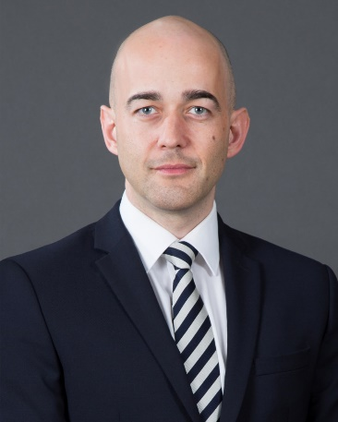


Aaron Le Marquer
T: +66 2056 5784
E-mail: Aaron.L@Tilleke.com
For more information please visit our website:
www.tilleke.com
www.facebook.com/tillekegibbins
twitter.com/tillekegibbins

